Slide 1
SPEECH TO SIGN LANGUAGE Translator application
Cse 3200: System development Laboratory

Slide 2
Presented by
Ashikur Rahman
Roll: 1707090
Year: 3rd Term: 2nd
Samin Yeasar
Roll: 1507099
Year: 3rd Term: 2nd
Department of Computer Science and Engineering Khulna University of Engineering and Technology

Slide 3
Supervised by
Dr. Sk. Md. Masudul Ahsan
Professor
Department of Computer Science and Engineering
Khulna University of Engineering and Technology

Slide 4
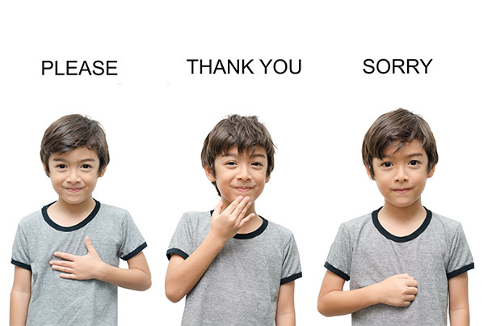
Sign language
Languages that use the visual-manual modality to convey meaning.
Expressed through manual articulations in combination with non-manual elements.
Full-fledged natural languages with their own grammar and lexicon

Slide 5
There are around 72 million people worldwide who use sign language
- World Federation of the Deaf (WFD)
International Day Of Sign Languages 2020: The Rights Of Sign Language Users

Slide 6
Rights of Sign language users
Sign languages are equal in status to spoken languages
Allows deaf people to choose to give and receive official communications in the way they choose, including in sign languages
Obligates the governments to encourage the learning of sign language and promote the linguistic identity of the Deaf Community
Requires the governments to provide early and comprehensive information, services and support to children with disabilities and their families, including information about deaf culture, sign language and bilingual education.

Slide 7
Previous works
Not enough works and developments in speech to sign language interpretation
“Speech to Sign Language Interpreter System (SSLIS)” by Khalid et al. (2006)
Signtel Interpreter™ (2010)
Hand Talk (2012)

Slide 8
For effective and proper communication with sign language users we need a two way conversion system of sign language-
Sign language to text/speech
Speech to sign language
In this project, we worked on the part of converting speech (including text) to sign language.

Slide 9
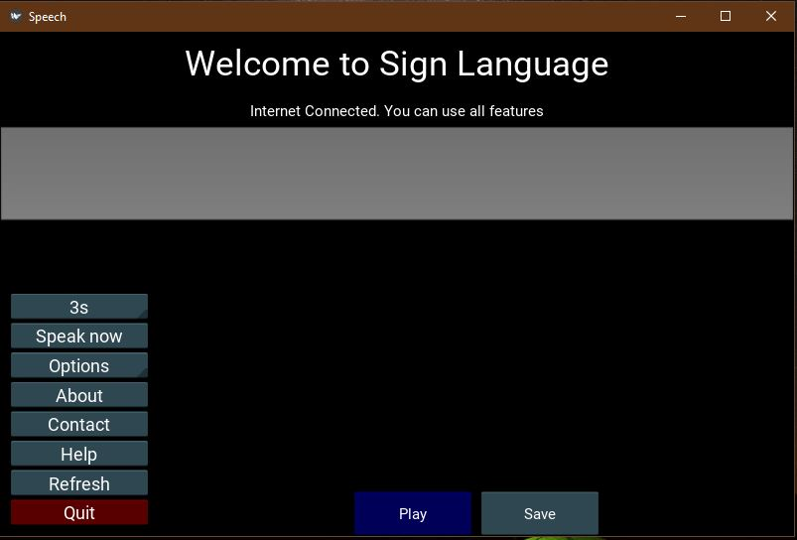
SPEECH TO SIGN LANGUAGE Translator application
We have developed a speech to sign language translator application
Written in Python language using Kivy, a cross-platform framework

Slide 10
KEY Features
Applications and use of the system

Slide 11
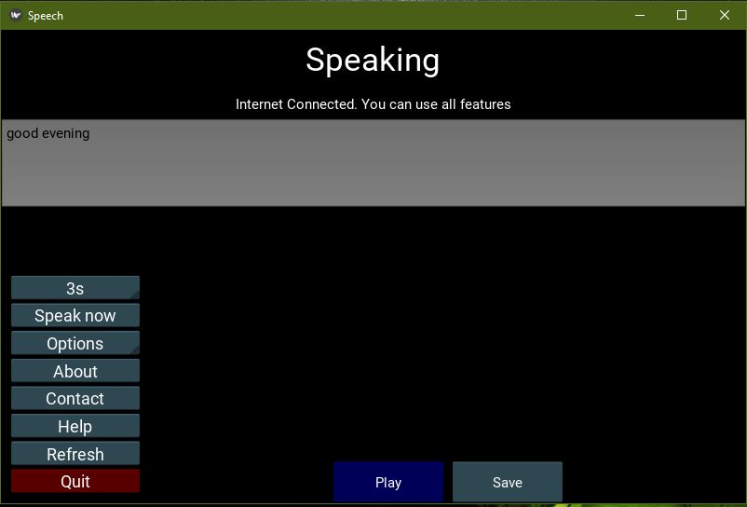
Real time Audio Input
System can capture the user’s speech from microphone or any audio input of the device
User have to select the maximum duration before speaking

Slide 12
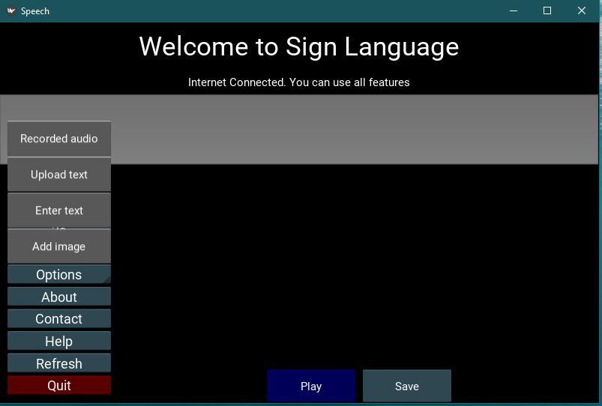
Recorded Audio Input
System can load recorded audio file

Slide 13
Text input
User can insert text directly by typing
User can also give text file as input

Slide 14
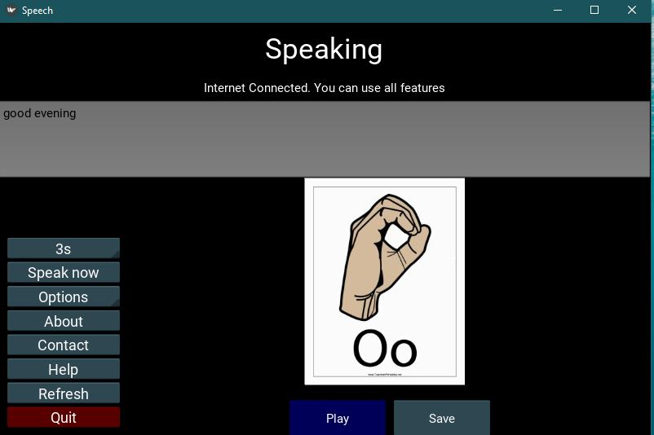
Video output
A video consisting of sign language equivalent of corresponding speech, text or recorded audio will be created
Deaf people can watch the video to understand the speech

Slide 15
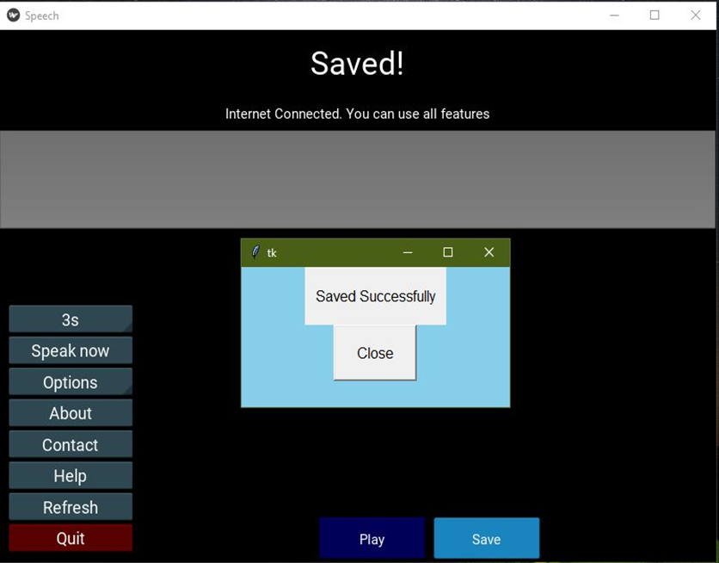
Video output
Video can be saved for later use

Slide 16
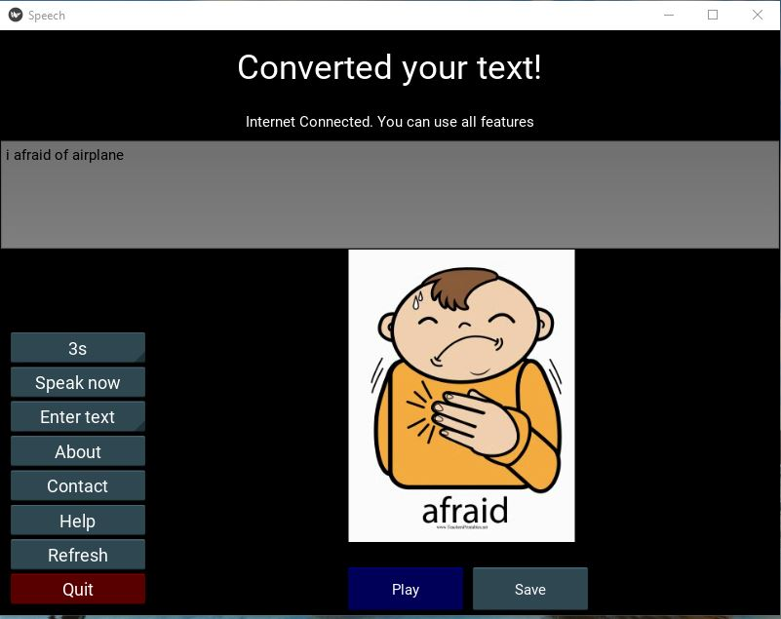
Images of sign of the corresponding words

Slide 17
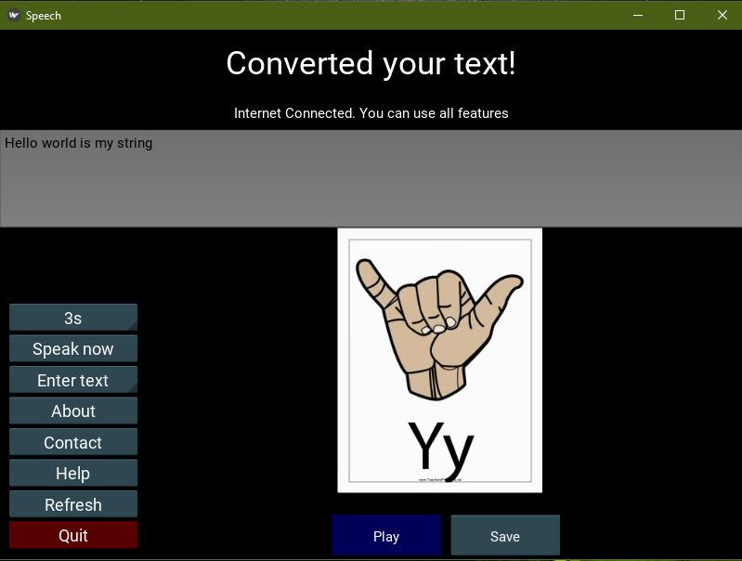
If the sign image of the word is not found, then the word is divided into letters
Sign of each letter is shown sequentially

Slide 18
Add image to database
User can upload image of corresponding word if no image is found

Slide 19
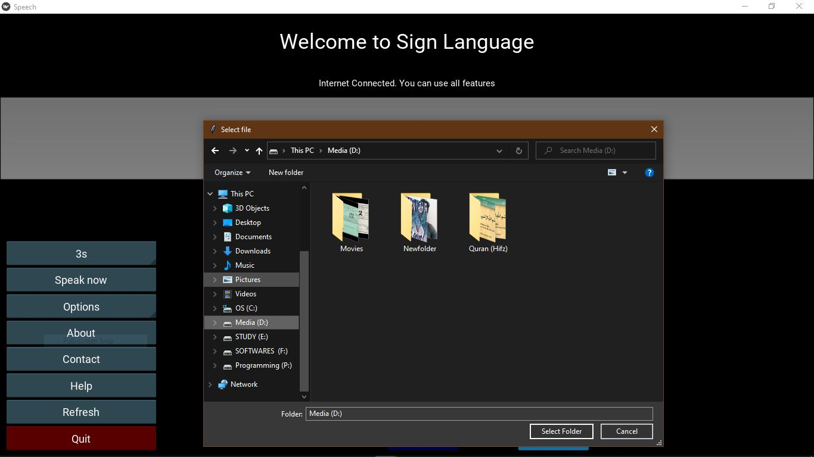
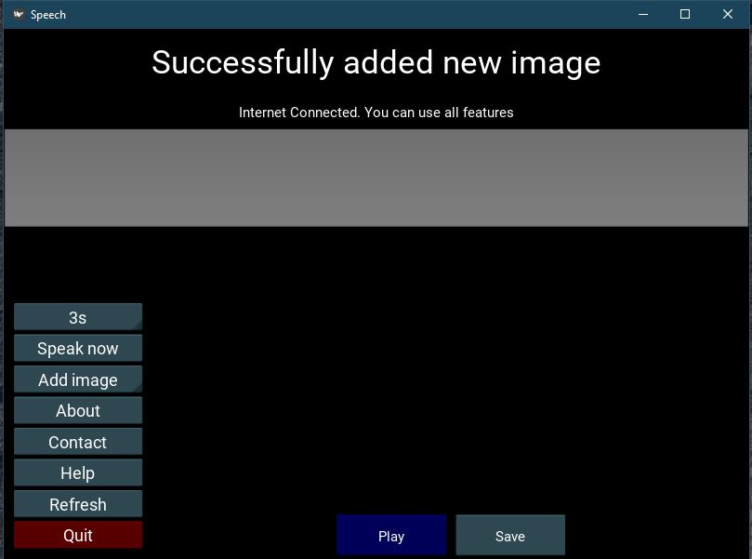
Add image to database

Slide 20
About button shows the information video about the project
Contact button shows contact information of developers
Help button shows a user manual video
Refresh button restart the session
Quit to close the program

Slide 21
System Architecture
Workflow, Overview, design & implementation

Slide 22
WORK Flow
Speech
Input from user
Text
Recognizing the speech and convert to text
Tokens
Text divided into tokens
Video
Images
Images are matched from database with corresponding token
Creating a video merging the images

Slide 23
System Overview
Hardware Requirements:
•Desktop/Laptop Computers
•Microphone / Audio input port
Software Requirements:
•Operating Systems: Windows 7 and above
Other Requirements:
• Internet connectivity for output from speech input

Slide 24
System Overview
Resources Used in Development:
Language: Python 3.6
Framework: Kivy
API: Google Cloud Speech-to-Text API
Libraries: PyAudio v0.2.11
SpeechRecognition 3.8.1
IDE: PyCharm 2021.1.1

Slide 25
Why kivy?
Cross-platform framework
Same project can be used to publish apps on iOS , Android , Windows , etc.

Slide 26
System Design
User Interface
Speak Now
spinner_clicked
ASvdo.py
ImgtoVid
fetchimg
sign.py
record
refresh
Database
Saved Images
tokenize
clear
audiototext
backup
spinner_clicked
save
play
del_punct
addimage
Saved Videos
Temporary saved images for video

Slide 27
System Design
User Interface
Audiototext
del_punct
tokenize
ASvdo.py
ImgtoVid
fetchimg
sign.py
record
refresh
Database
Saved Images
tokenize
clear
audiototext
backup
spinner_clicked
save
play
del_punct
addimage
Saved Videos
Temporary saved images for video

Slide 28
System Design
User Interface
Fetch image
ASvdo.py
ImgtoVid
fetchimg
sign.py
record
refresh
Database
Saved Images
tokenize
clear
audiototext
backup
spinner_clicked
save
play
del_punct
addimage
Saved Videos
Temporary saved images for video
Final image folder

Slide 29
System Design
User Interface
imgtoVid
ASvdo.py
ImgtoVid
fetchimg
sign.py
record
refresh
Database
Saved Images
tokenize
clear
audiototext
backup
spinner_clicked
save
play
del_punct
addimage
Saved Videos
Temporary saved images for video
Output folder

Slide 30
System Design
User Interface
UI
play
ASvdo.py
ImgtoVid
fetchimg
sign.py
record
refresh
Database
Saved Images
tokenize
clear
audiototext
backup
spinner_clicked
save
play
del_punct
addimage
Saved Videos
Temporary saved images for video

Slide 31
System Design
User Interface
Add image
Save Video
ASvdo.py
ImgtoVid
fetchimg
sign.py
record
refresh
Database
Saved Images
tokenize
clear
audiototext
backup
spinner_clicked
save
play
del_punct
addimage
Saved Videos
Temporary saved images for video

Slide 32
Limitations
Insufficient library and datasets
Less UI effects on Kivy

Slide 33
Future Prospects
Two-way communication with sign languages
Integration with chatting apps. ex: Messenger
Plugins (subtitle) of video streaming website. ex: YouTube
Multi-lingual use ex: Higher study abroad

Slide 34
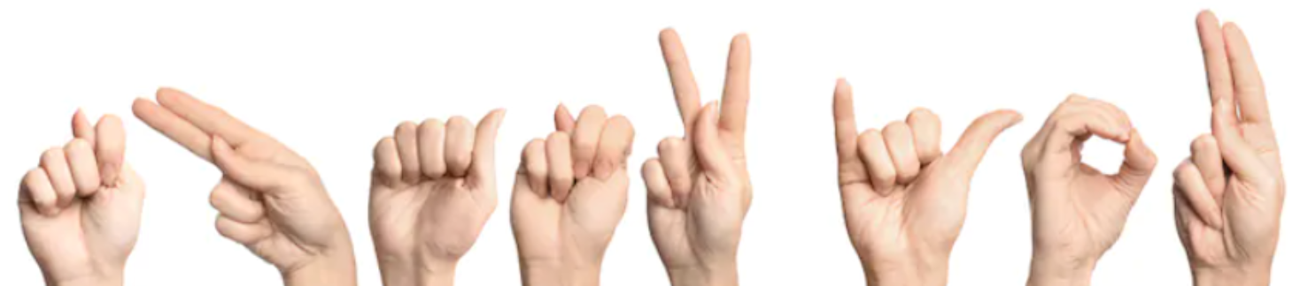
THANK YOU

Slide 35
THANK YOU

